Slide 1
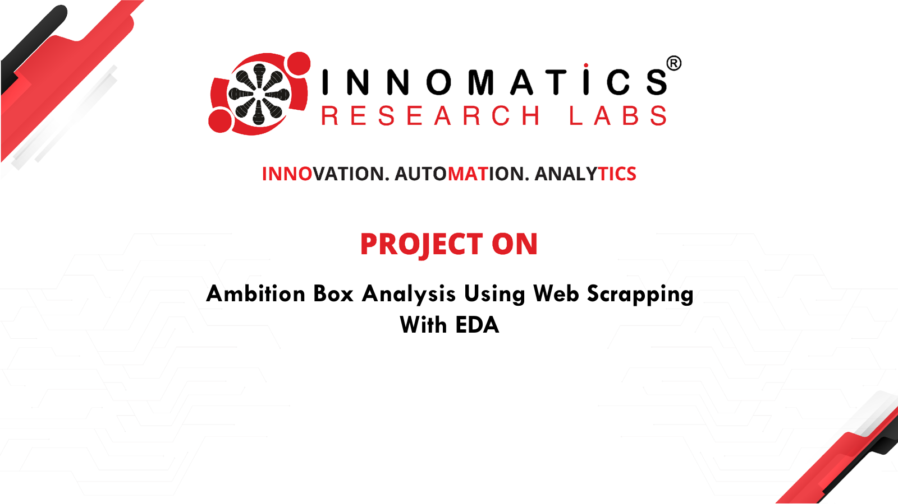

Slide 2

About me
“ I’m Sripada Jain, a B.Tech graduate in Mechanical Engineering from CMR College of Engineering and Technology.”
“I’m passionate about using data to solve real-world problems. During my studies, I developed an interest in analytical thinking and working with data-driven tools. Data Science combines logic, technology, and business insights, and I believe it’s the right field to apply my analytical mindset and grow my career in a technology-driven domain.”

Slide 3
AGENDA
Problem Statement
Objective
Web Scrapping Details - (Website ,Tools used , Steps)
Summary Of Data
Exploratory Data Analysis (EDA)
Data Cleaning Process
Data Manipulation
Univariate Analysis
Bivariate Analysis
Experience and Challenges
Conclusion

Slide 4
Problem Statement
This Project analyzes the top 500 companies listed on Ambition Box to uncover real-time hiring trends, employee sentiment, and workplace satisfaction across industries in India. It examines how promotions impact work satisfaction, identifies top industries for job security, and highlights companies leading in job openings, ratings, and employee reviews.
The goal is to help job seekers and stakeholders understand where top opportunities exist.

Slide 5
Objective
Scrape company listings from Ambition Box (Top 500).
Clean, structure, and prepare data for analysis.
Deliver actionable insights for job seekers and recruiters.

Slide 6
Web Scraping Process
Website: https://www.ambitionbox.com/listcompanies?campaign=desktop_nav
Tools Used: Python, Beautiful Soup, Requests, Pandas ,seaborn
Steps:
Import required libraries (requests, Beautiful Soup, pandas, seaborn).
Send an HTTP request to the website URL using requests.get ().
Parse the webpage content using Beautiful Soup.
Store the extracted data into a pandas Data Frame.
Clean, analyze,visualize and Export the final dataset to a CSV file.

Slide 7
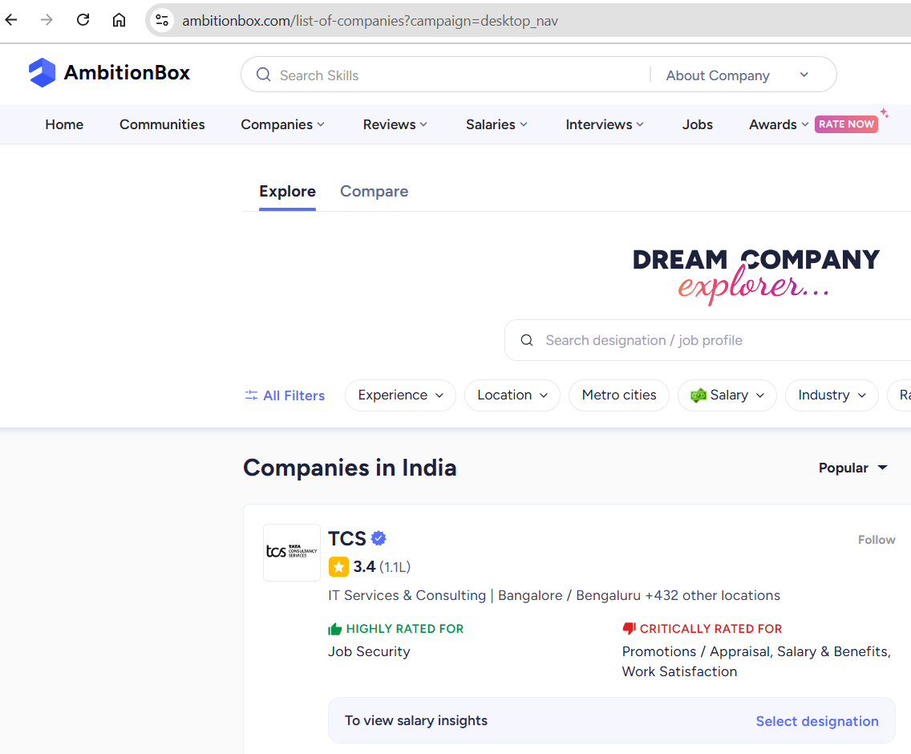
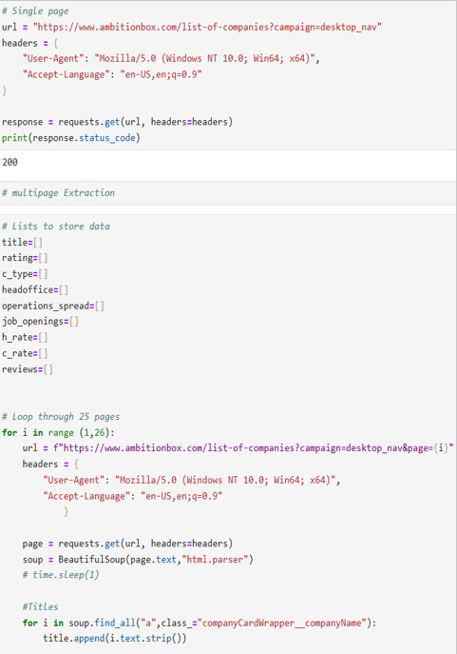

Slide 8
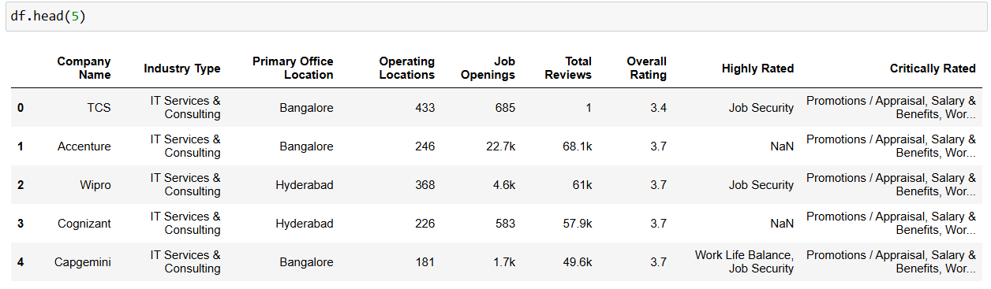
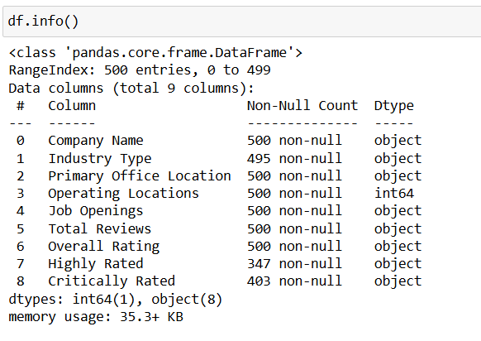
Summary of the Data

Slide 9
Exploratory Data Analysis (EDA)
Data Cleaning Process :
Created Feature Columns :
Extracted Job Security, Work Life Balance, etc., from text ratings.
Dropped Redundant Columns :
Remove “Highly Rated” and “Critically Rated” columns.
Cleaned Numeric Columns :
Fixed Job Openings and Total Reviews by handling ‘k’, ‘–’, and ‘nan’.
Fix Industry Type :
Stripped spaces and replaced missing values with “other”.
Converted Ratings to Float :
Changed Overall Rating to float for analysis.
Converted to Category Type :
Optimized selected columns for memory and clarity.

Slide 10
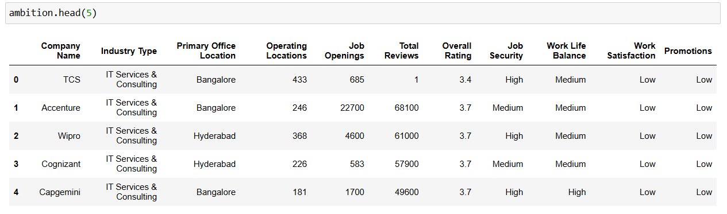
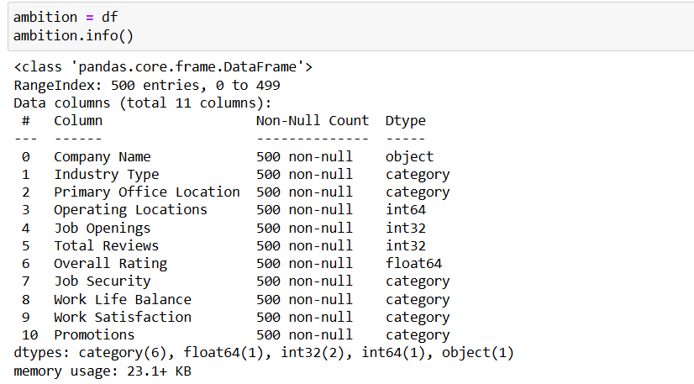

Slide 11
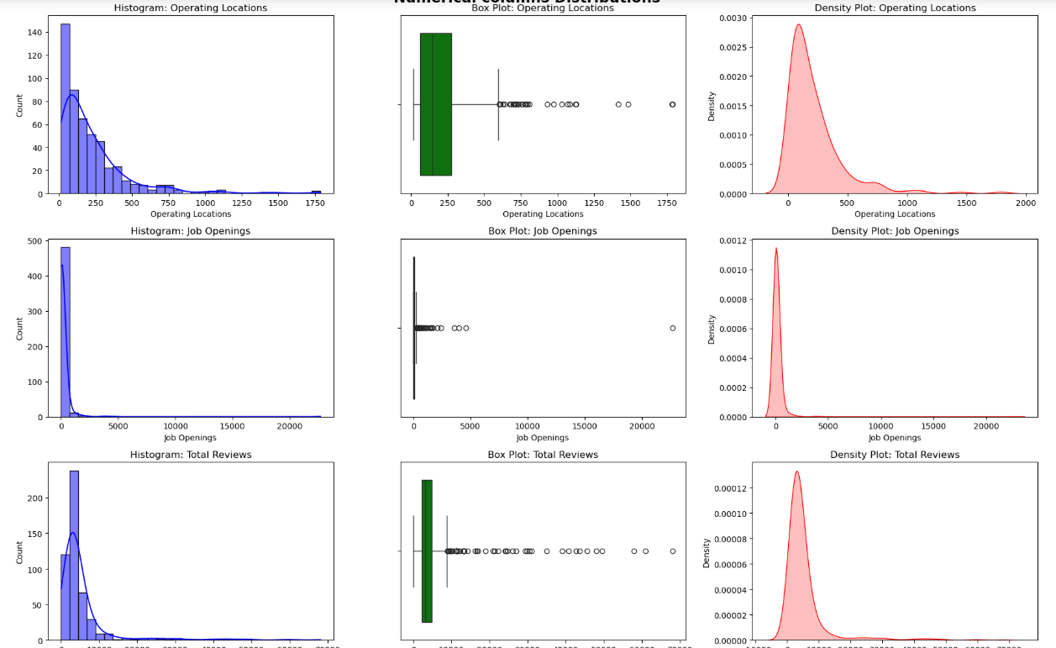
Univariate Analysis (Numerical)

Slide 12

Numerical Insights
The plots analyze four numerical features Operating Locations, Job Openings,Total Reviews, and Overall Rating.
Histograms show how data is distributed across each feature.
Box plots help identify outliers clearly in all features.
Density plots (KDE) represent the probability distribution smoothly.
Operating Locations, Job Openings, and Total Reviews are right-skewed, meaning most values are low but few companies have very high numbers.
Overall Rating follows an approximately normal distribution, centered around 3.5–4, showing most companies have average to good ratings,reflecting balanced employee feedback.
This univariate analysis helps identify data spread, outliers, and skewness, useful for cleaning and future modeling.

Slide 13
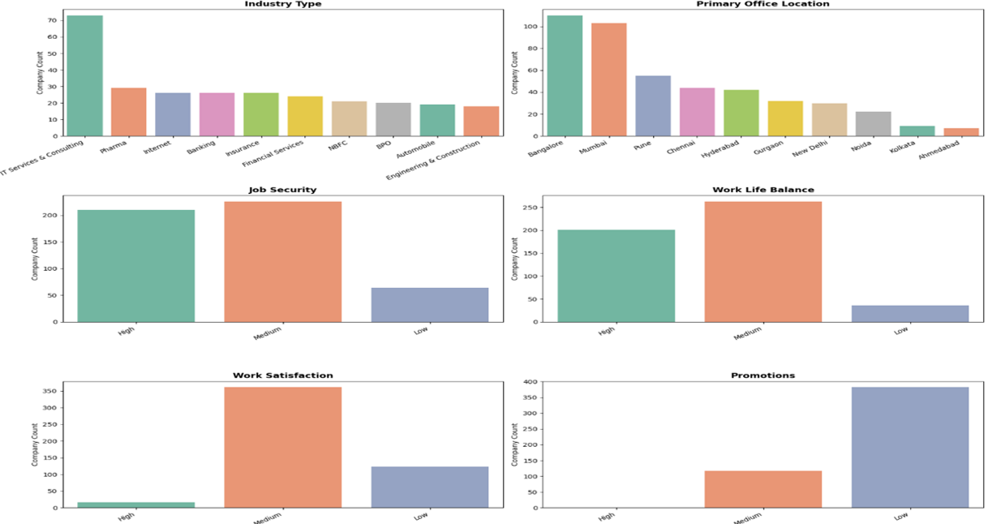
Univariate Analysis (Categorical)

Slide 14
Categorical Insights
The dataset includes multiple categorical features such as Industry Type, Primary Office Location, and various satisfaction metrics.
IT Services and Internet Companies dominate the Industry Type distribution.
Bangalore, Mumbai, and Hyderabad appear most frequently as Primary Office Locations.
Job Security ratings are mostly on the higher side (3–4 range), indicating employee stability.
Work Life Balance scores are moderate to high, showing good workplace culture in most companies.
Work Satisfaction levels are consistent, with most ratings clustered around 3.5–4.
Promotions and career growth opportunities vary widely across industries.
The data reveals some imbalance — a few industries and locations dominate the dataset.
Employees from major tech hubs show slightly better satisfaction and balance ratings.
Overall, categorical analysis shows concentration in IT-related fields and metro cities with positive employee perceptions.

Slide 15
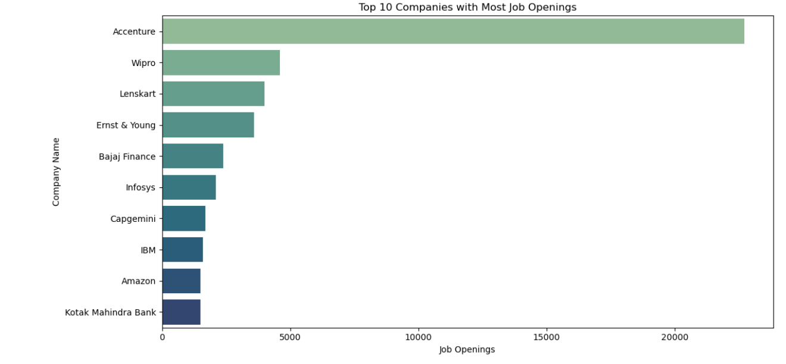
Bivariate Analysis
Top 10 companies With Most Job Openings
key insights from bar chart showcasing the top 10 companies with the most job openings:
Accenture dominates hiring-signaling aggressive tech expansion
Wipro is second- hiring steadily but conservatively
Hiring spans industries banks, e commerce, logistics all active

Slide 16
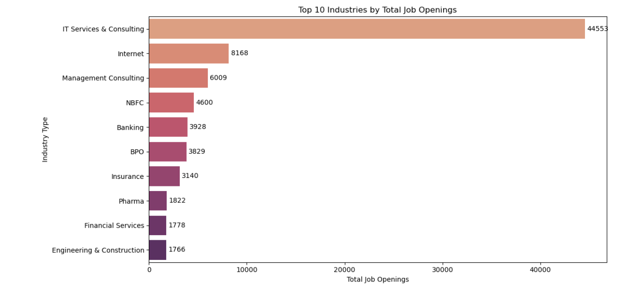
Top 10 Industries By Total Job Openings
Top Hiring Sectors: Who's Leading India's Job Market
1.IT Services & Consulting leads - hiring surges with overwhelming demand
2. Insurance & Internet tie digital and financial sectors booming.
3. Finance sectors strong - Banking and NBFC show steady hiring volumes.

Slide 17
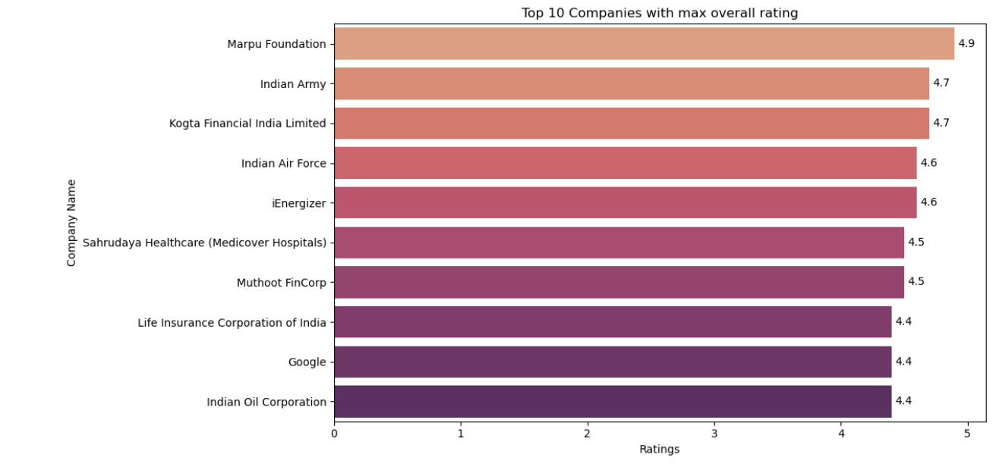
Top 10 Companies With Max Overall Rating
1.Marpu Foundation tops the list with an impressive 4.9 rating
2. Indian Army and Indian Air Force rank high, reflecting strong employee sentiment in defense.
3. Energizer and Kogta Financial show private firms can also earn excellent reviews.
4.A mix of sectors- from healthcare to banking suggests great workplaces span across industries

Slide 18
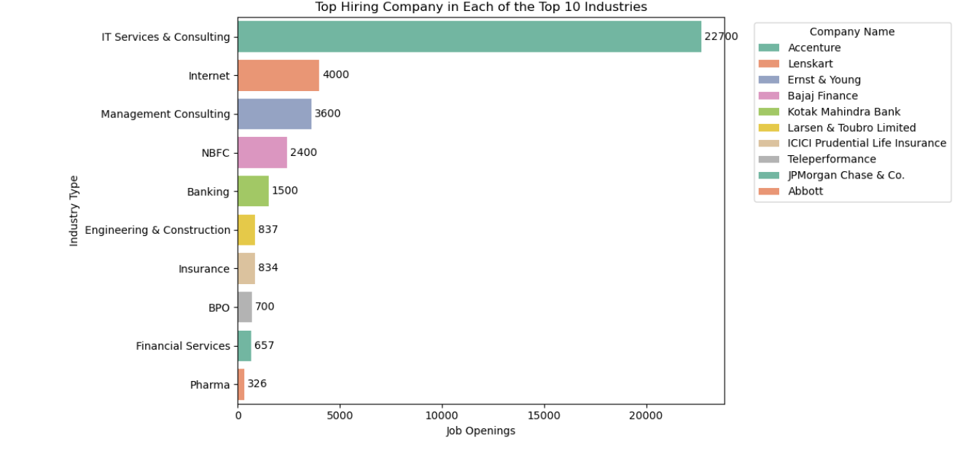
Top Hiring Company in Each Of the Top 10 Industries
Accenture leads hiring in IT Services with 14.6k openings.
Amazon, Cognizant, and Kotak top hiring in Internet, Consulting, and Insurance sectors
Banking, Pharma, and NBFCs also show strong demand, beyond core tech
Hiring is concentrated among a few dominant firms in each industry.

Slide 19
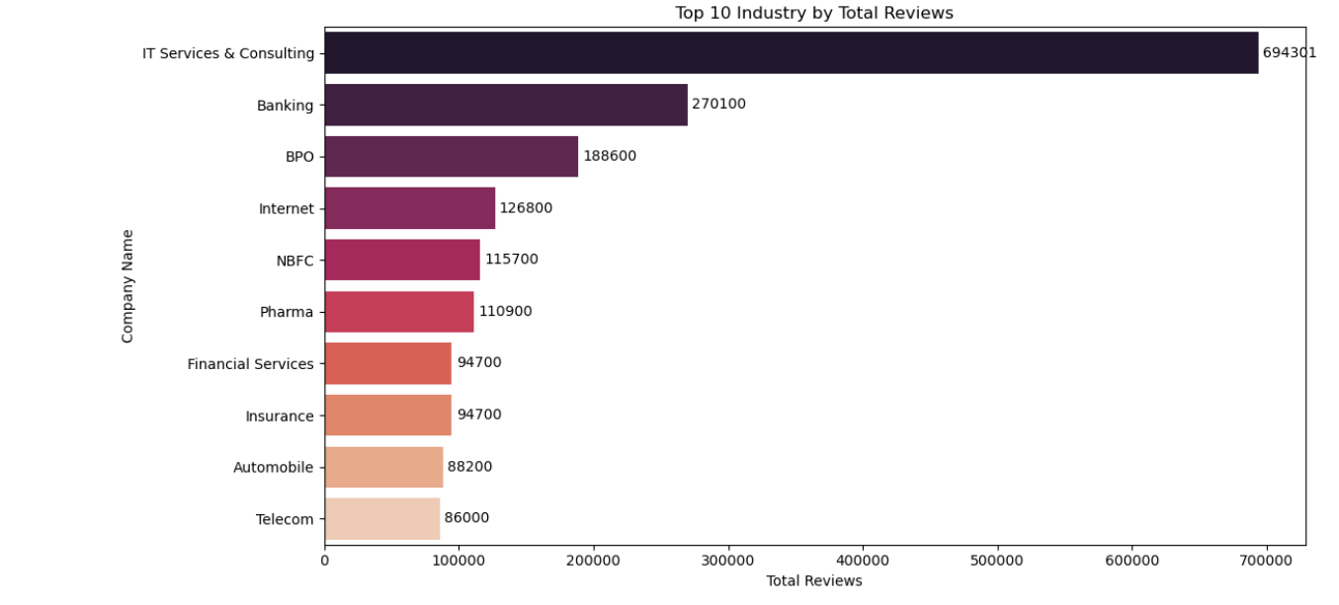
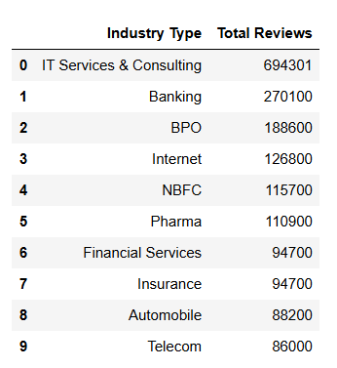
Top 10 Industry by Total Reviews

Slide 20
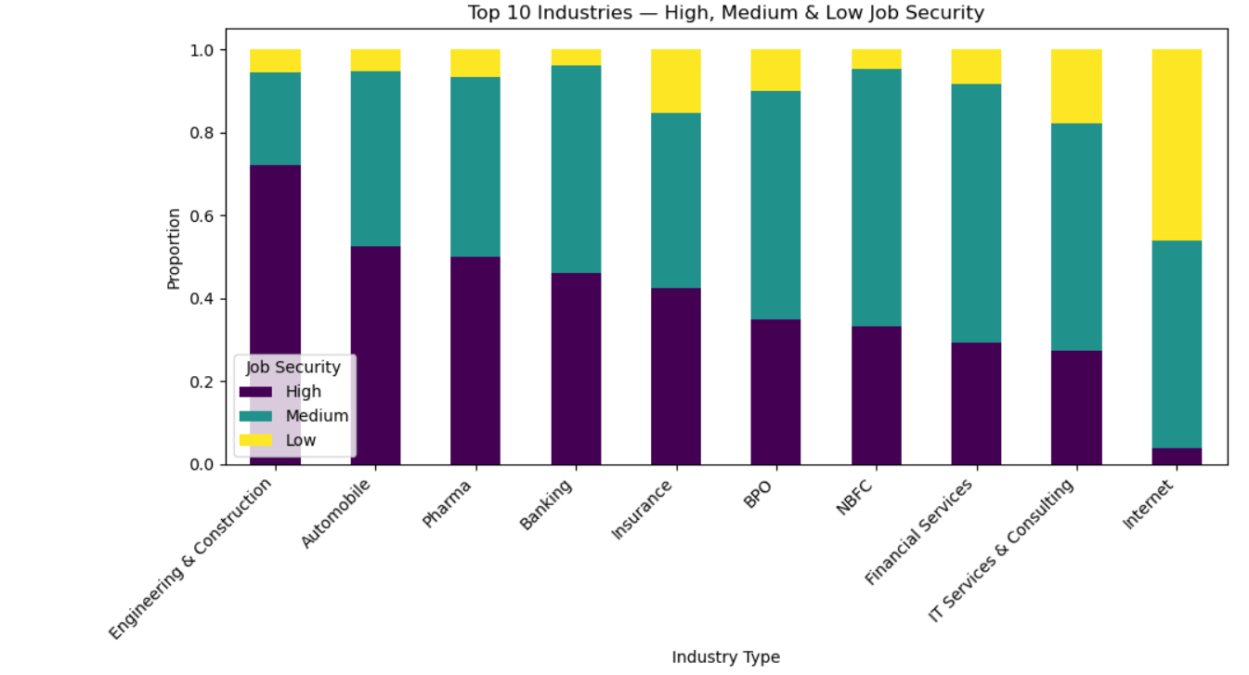
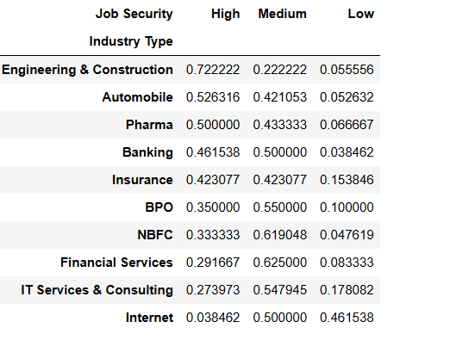
Job Security Distribution Across Top 10 Industries

Slide 21
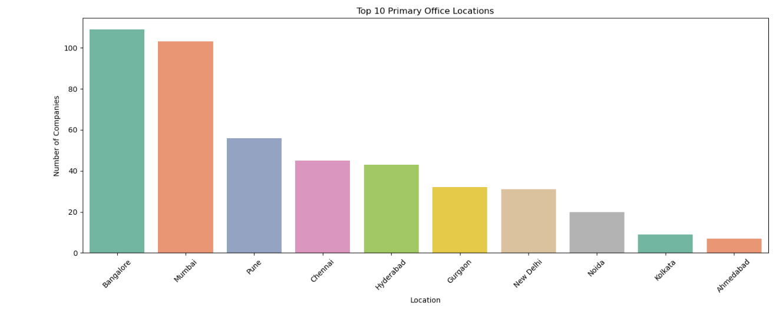
Top 10 Primary Office Locations

Slide 22
Experience / Challenges
Faced issues with changing website structure while scraping.
Cleaned and handled missing or duplicate data.
Used Beautiful Soup, Requests, and Pandas for data extraction and analysis.
Faced challenges in extracting and cleaning real-time web data.
Learned practical skills in data scraping, preprocessing, and visualization.
Learned to visualize insights using Seaborn and Matplotlib.
Gained real-time experience in data collection and EDA.

Slide 23
Conclusions
1.IT Sector is the largest : Over 35% of top companies are from IT Services & Consulting, showing it's the biggest hiring sector.
2. Diverse Industries Included : Other major industries include Banking, BPO, Pharma, and Retail, reflecting a wide range of company types.
3. Top Job Locations : Most company headquarters are in Bangalore, Mumbai, Hyderabad, and Pune. These cities are major job and tech hubs.
4. Employee Experience : Job security and work-life balance are mostly rated as Medium or High Work satisfaction and promotions are often rated Low, suggesting ignited career growth.
5. Best Industries to Work In :
Defence & Railways - Average Rating: 4.3 Known for stability, respect, and long-term career growth.
Pharma & Healthcare - Average Rating: 4.0 Focused on employee well-being and a balanced work life.
Automobile & Industrial - Average Rating: 4.0 Offers process-oriented environments and growth opportunities.
FMCG & Retail - Average Rating: 3.9 Known for strong organizational systems and workforce diversity.
Software Product Companies - Average Rating: 3.9 Recognized for innovation and global career exposure.

Slide 24


